Slide 1
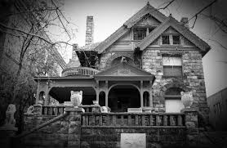
Fredonia Haunted House
Are You Brave Enough to Enter?

Slide 2
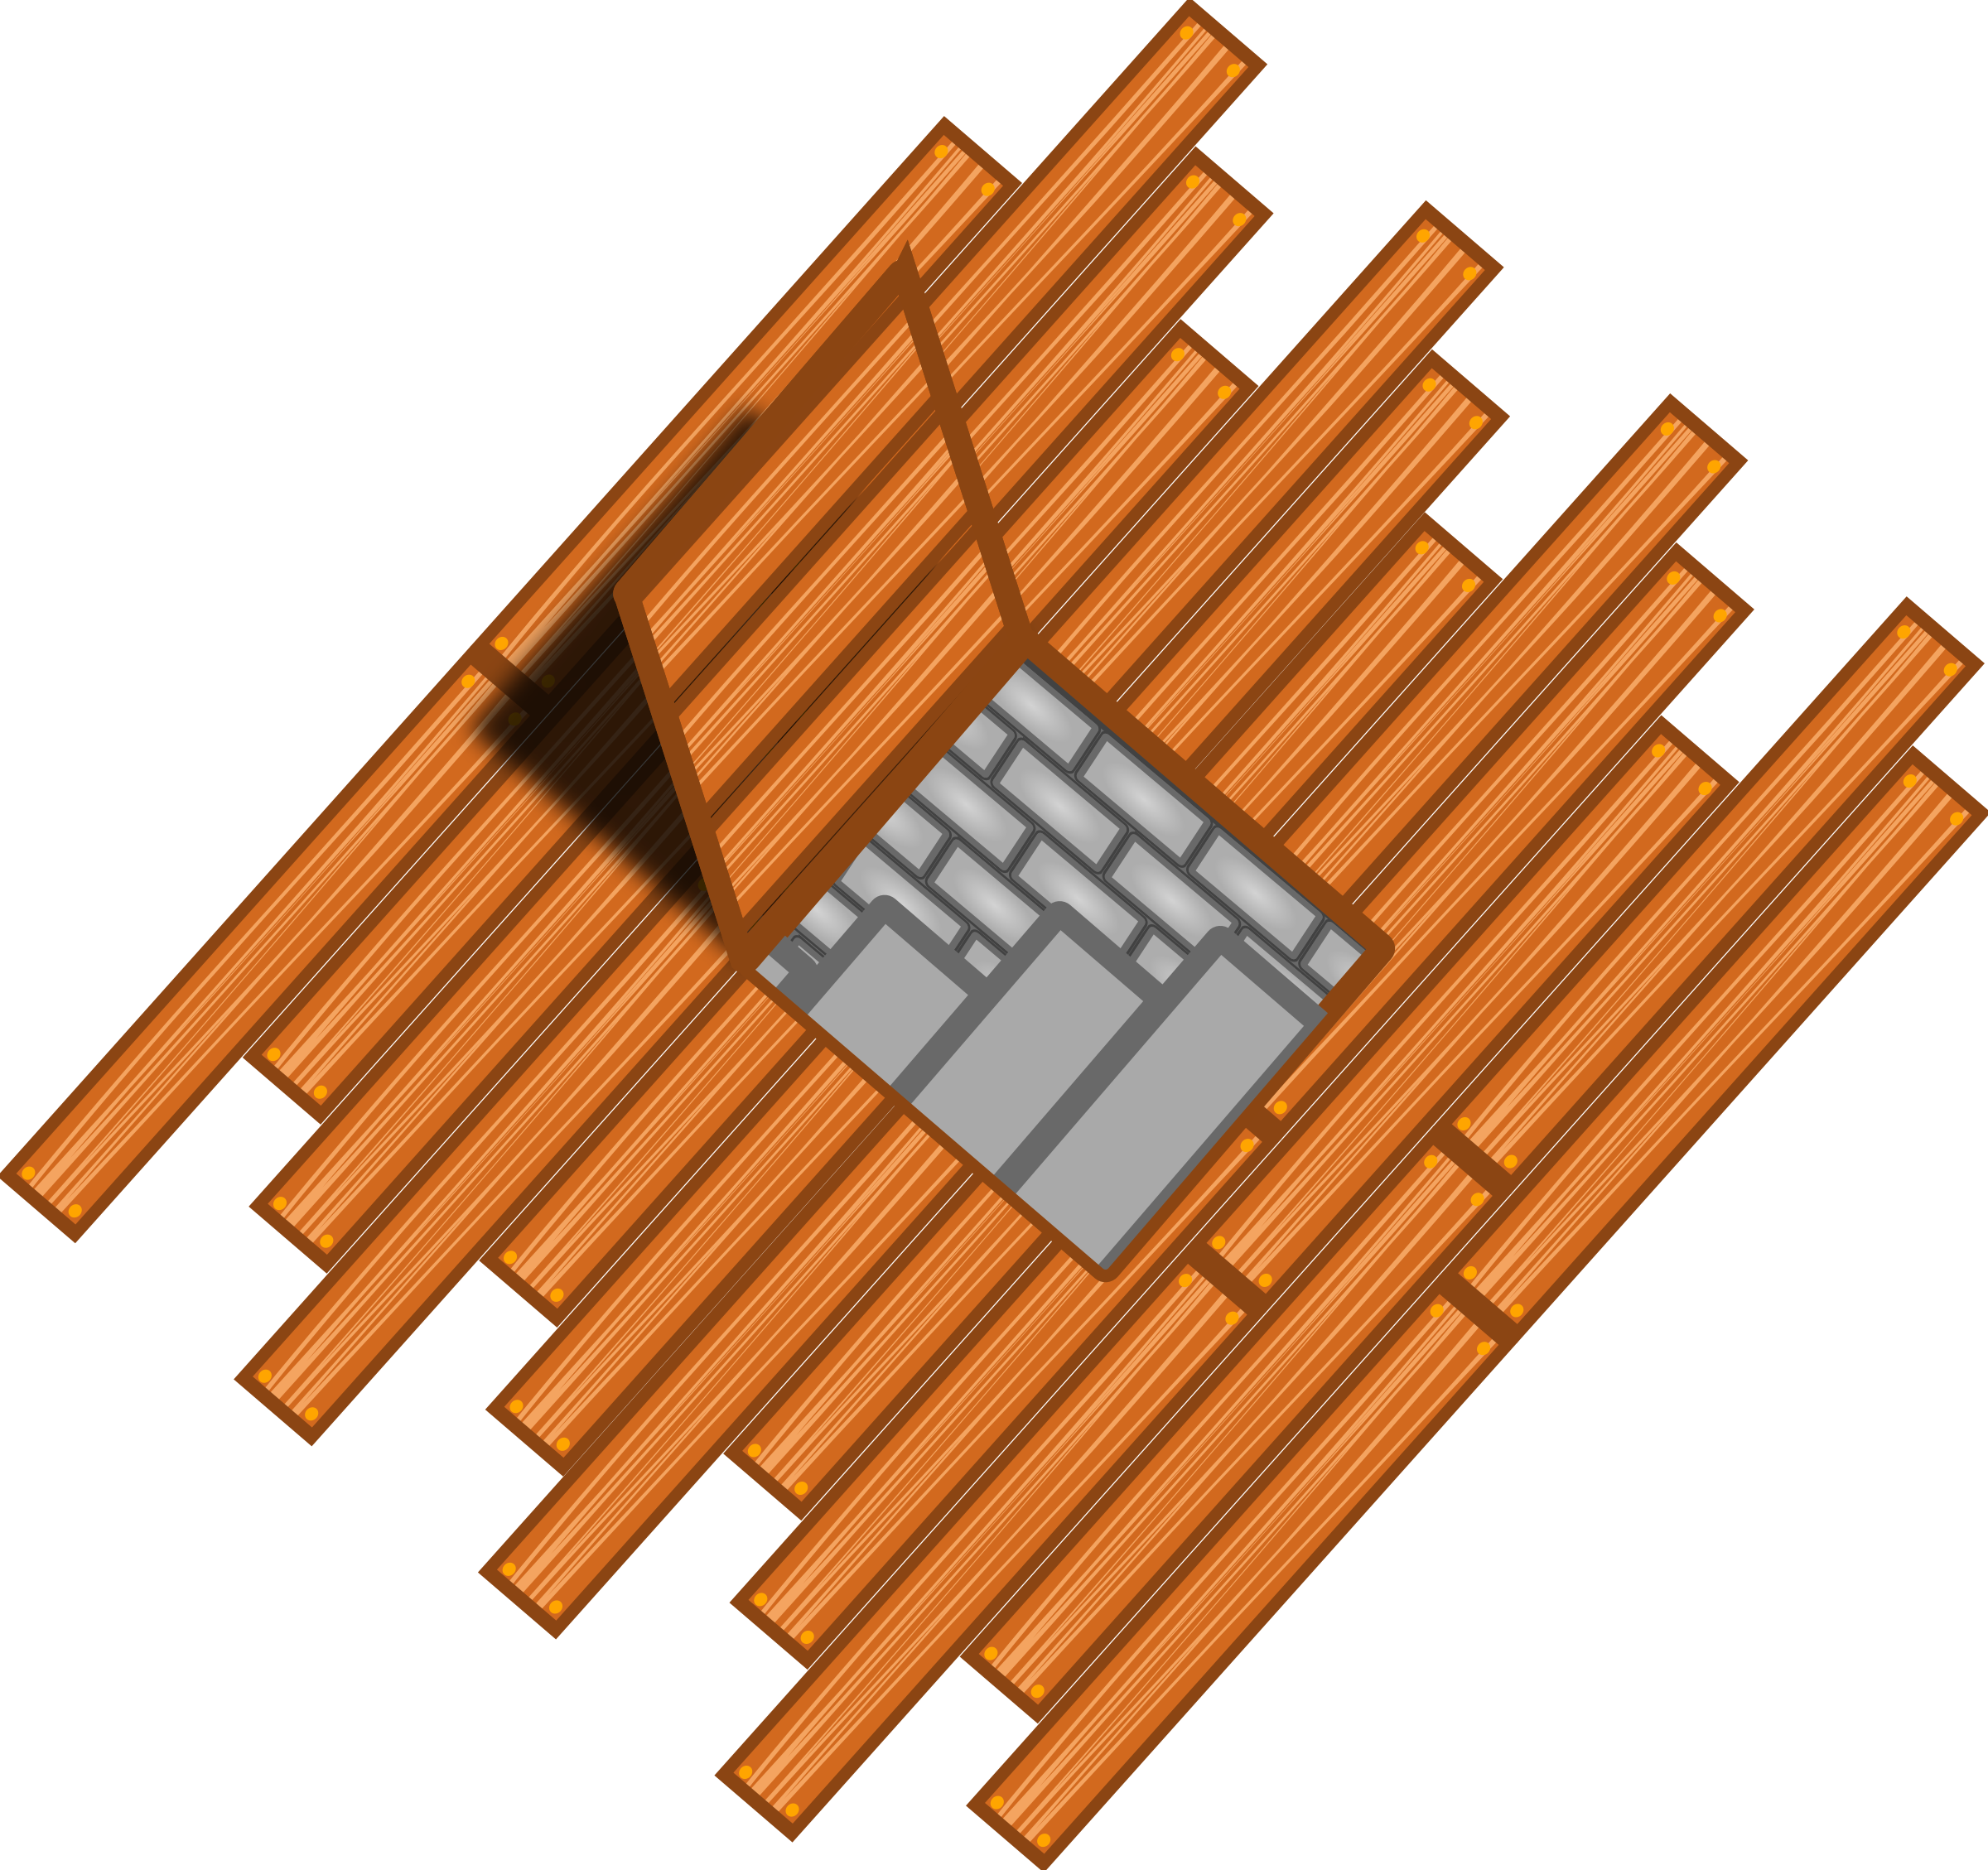
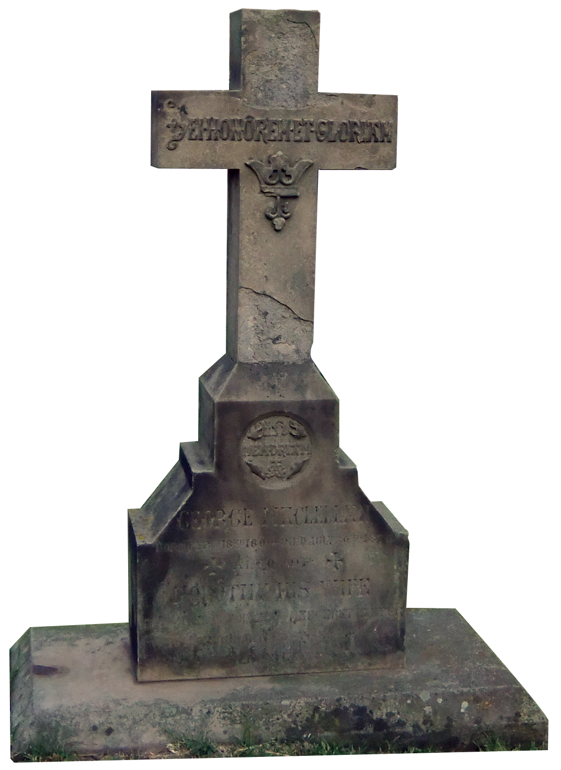
Where Do You Dare to Venture?

Slide 3
Dining Room
By the age of 27, Mary N. Khillem has been married six times, each husband increasing in age. She is known to have poisoned and killed all but one of those husbands at this very table. Mary N. Khillem did so by using her secret ingredient: a dash of Ricin, into her husbands’ cocktails. Her famous plating of the table, remains left just the way she had it when she also died in this house, by accidentally ingesting some of the leftover poison that was intended for her husbands. You may recall that there was one other husband, who was not poisoned, but ironically, and to Mary N. Khillem’s convenience, he was also murdered here in this house, by a salesman turned serial killer who was invited into the house and got angry when Mary’s huband did not want to buy his product. Mary N. Khillem was so thrilled and impressed by the salesman, that she offered him one of her famous cocktails. His body is also buried in the back yard.
I want my money back. Start me over.
Be our guest… to the next room.

Slide 4
Graveyard
You walk around the house and find a graveyard…
After wandering a bit, you realize that every person in this graveyard once lived in the house. As you are reading one gravestone, you feel a tap on your shoulder... RIP

Slide 5
You Panic and flee! Continue to the kitchen?
Or Return to the Start?

Slide 6
Kitchen
You enter the kitchen and find a note on the counter and a TV on the table… After reading the note, the TV mysteriously begins to play.
“There once lived a happy couple, Tommy and Sarah. One day Sarah had enough, and stabbed Tommy in the head with a knife from this kitchen. You’d think that was the end of it, but… Let’s just say they are going to need more than marriage counseling to fix this relationship.”
I’m never getting married after that, take me back to the Start
More Please!

Slide 7
Study
This very house, at one point, belonged to “The Unsinkable Molly Brown,” one of the only people to survive the Titanic. Rumor has it, after she returned home, she believed she was so invincible and thought so highly of herself, that books and stories were no match to her own adventure, and that people should be reading her story. It is said she trashed her own library, then never picked up a book again until the day she died. She was proud of three things when she died: her family, her miraculous survival of such a terrible tragedy, and the fact that her character co-starred next to Leonardo DiCaprio in the award winning film,Titanic. It is not uncommon for her to stick around the house to make sure we tour guides do our job and mention her wonderfulness. She is the first to correct us when we fail to include some important information, by subtly throwing books on the floor or punching us in the face. Through a recent ouija board encounter with Ms. Brown, she has made it clear, that she too, agrees with the Mythbusters and the rest of the world, that both Jack and Rose could have fit on the door and his death was preventable.
Why are we talking about a boat? Let’s try this again.
Yeah, no thank u, next.

Slide 8
Bedroom
Little Kate, only ten,
Living inside this pink room.
Accused of witchery,
She did not know,
About her impending doom.
It was here she was murdered,
For casting a spell,
It was here, they discovered,
They didn’t know her that well.
They were looking for a Kate,
But one who lived up the street,
They knew in that moment,
They must be quick on their feet.
These boneheads screwed up,
And had the wrong house’s number.
Little did Kate know, she’d be killed by
Dumb and Dumber.
So poor Little Kate,
Who had loved Harry Potter,
Was practicing her spells,
When they came in and shot her.
This is dumb. Take me back to the beginning.
Please tell me the next room is actually scary.

Slide 9
Basement
You enter the basement, where you find a horde of ghosts. Although terrifying, they seem pretty friendly. One little girl ghost named Kate, asks excitedly:
“HOW WOULD YOU LIKE TO PLAY A LITTLE GAME TO SAVE MY FAVORITE ARTIST?”
Yes or No
BEWARE: Kate’s game is not one everyone comes back from…
I Wish to End this Tour…
or
Take Me Back to the Lobby

Slide 10
Congratulations! You made it Out Alive!

Slide 11
Gotcha!

